Slide 1
Advanced Developmental Psychology
PSY620
Notes:
Psychology of Infancy

Slide 2
Parenting
Attachment security (video): stability & instability
Sensitivity→security (ppt18)
Attachment predicts
Sensitivity/security→outcome
Is sensitivity maximal responsivity? (Bornstein via Shuo)
Early sensitivity→(academic) outcome (Raby via Jiye)
Adult attachment interview
Preschool rule-breaking→parental power assertion→antisociality (effects on parenting)
Spanking→poor academic & social outcomes
Single study
Meta-analysis
Maternal warmth & intrusiveness
Interaction in AA dyads (Ispa)

Slide 3
Large scale study stability is modest but instability is predictable
MLS Marginal stability for A, B, C, and D classifications from 18 to 36 months
Kappa = .06; p < .05
Seifer et al
NICHD Modest stability for A, B, C, and D classifications from 15 to 36 months
Low maternal sensitivity from 24 to 36 months
→ secure to insecure shift
Higher maternal sensitivity from 24 to 36 months → insecure to secure shift
NICHD Early Child Care Research Network, 2001, Dev. Psy

Slide 4
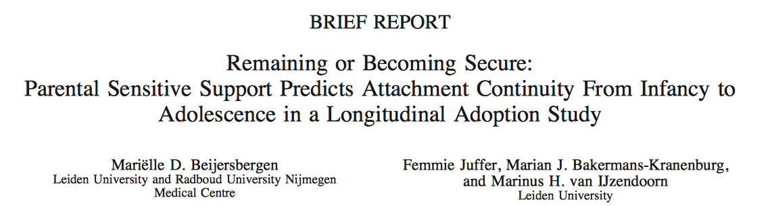
Sensitivity predicts continuity
Secure-secure mothers more sensitive at 12 months and 14 years old than secure-insecure
Insecure-insecure vs. insecure-secure
Insecure-secure group had less supportive mothers at 12 months but more supportive mothers at 14 years old
Stressful life events and temperament did not predict attachment continuity

Slide 5
Continuity of Attachment not significant
Adolescents
Mothers of secure adolescents showed more sensitive support at 14 years
Overall, 39% secure, 61% insecure

Slide 6
Attachment & emotional development
In 2nd and 3rd yrs, secure children → less angry.
Higher attachment → less fear and anger at 33 mo
Insecure children's negative emotions increased:
Avoidant children → fearful
Resistant children were most fearful / least joyful,
distress even in episodes designed to elicit joy.
Disorganized/ unclassifiable children →more angry.
Kochanska, G. Child Development. 2001, 72 474-490
Notes:
Attachment groups (avoidant, secure, resistant, and disorganized/unclassifiable) differed in the trajectories of emotional development, with the differences first apparent at 14 mo of age.

Slide 7
Proviso: Insecure attachment may have positive functions
The function of attachment is safety
Avoidance minimizes unfruitful attempts to elicit caregiving
Resistance maximizes attention to separation & minimizes separation
Even disorganization balances exposure to a threatening but needed caregiver
Security may not be the only way to ‘get it right.’
Crittenden (Dahra Jackson)
Age of menarche

Slide 8
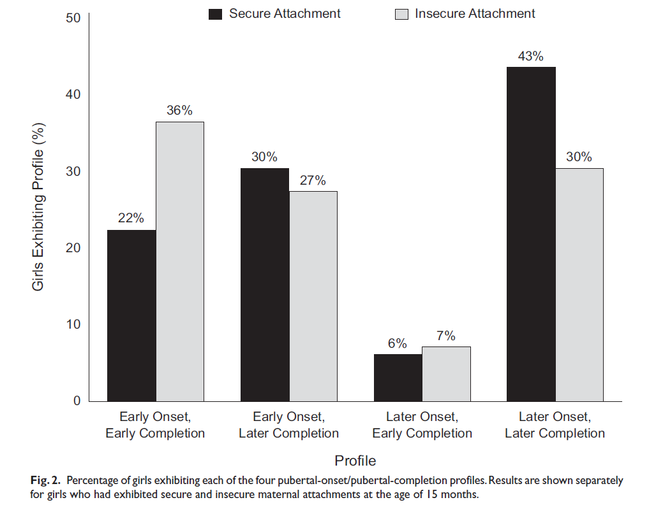
Attachment-Maturation Model
Early menarche: insecure over-represented?
Is insecurity a better fit to certain environments?
Belsky, Houts, & Fearon 2010

Slide 9
Attachment in the Early Life Course: Meta-Analytic Evidence for its Role in Socioemotional Development Groh et al., (2017)
Futterer

Slide 10
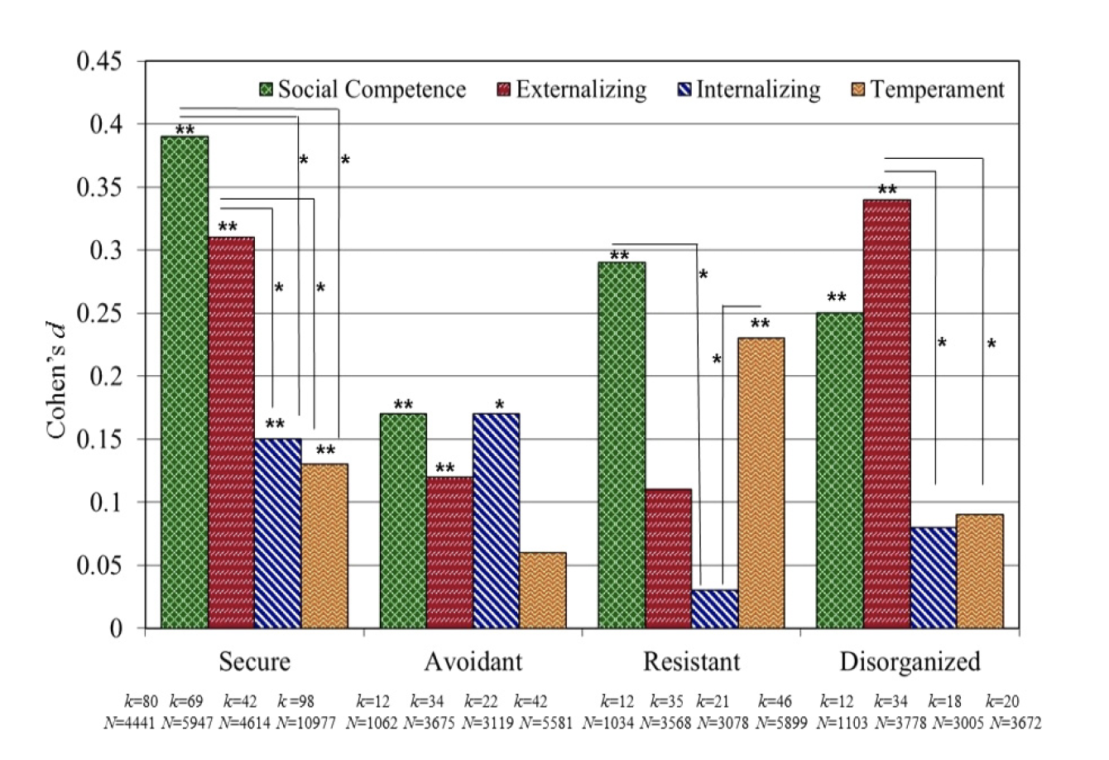
Significance of Early Security
Futterer
Groh, et al., 2017

Slide 11
Attachment Research
Attachment security
Socioemotional outcomes
???
Futterer

Slide 12
Significance of Early Security
Futterer

Slide 13
What about age?
Age of outcome assessment
Attachment Security
Externalizing problems
Temporal lag
Futterer

Slide 14
What about age?
Temporal lag
Attachment Security
Any association
Futterer

Slide 15
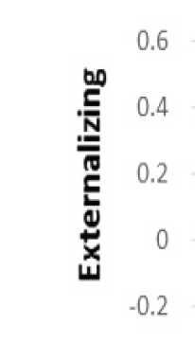
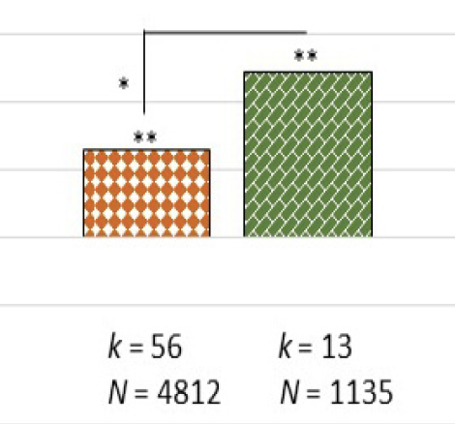

Other possible factors???
Futterer

Slide 16
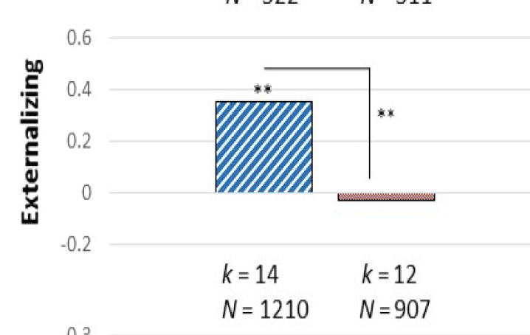

Other possible factors???
Futterer

Slide 17
What about insecurity?
Futterer

Slide 18
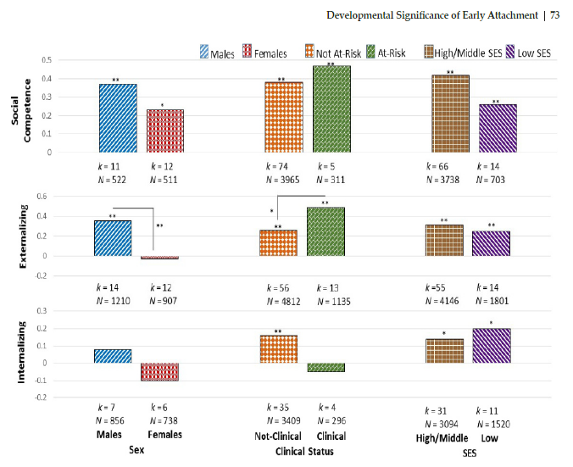
Security effects…moderated

Slide 19
Overall
Early attachment security:
is only weakly associated with infant temperament
has lasting significance for children’s socioemotional adjustment
More strongly related to social competence and externalizing problems than internalizing problems
Early attachment can inform models of psychopathology and adjustment, but it has its limits
Futterer

Slide 20
Evidence for sensitivity → attachment effects
Experimental
Irritable infants
Snugglies
Observational
Meta-analysis of quasi-experiments

Slide 21
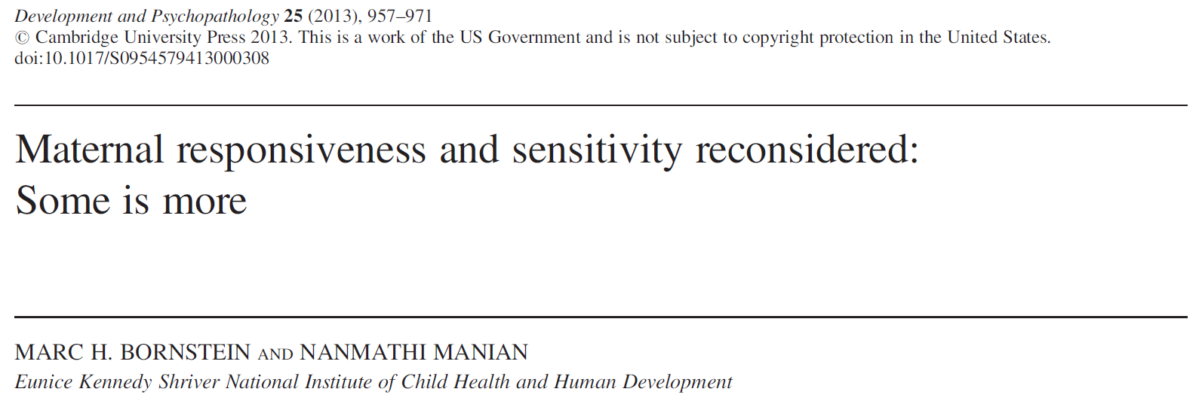
Borstein & Manian (2013)

Slide 22
What is Maternal Responsiveness?
Sensitive responsiveness to infant signals and communication
Recurring and meaningful sequences
Infant action and parent reaction that generalizes across caregiving contexts
Infant Action | Parent Reaction
Look at mother | Encourage attention to mother
Look at object | Encourage attention to object
Nondistress vocalization | Speech to the infant
Smile

Slide 23
Why does Maternal Responsiveness matter?
Sensitive Responsive
Secure Attachment
Behavioral Independence
Verbal ability, intellectual achievement
Attachment Style
Unpredictable Parenting
Indiscriminate
Parenting
Low
Medium
High
Maternal Responsiveness
Insecure Avoidant
Increased stress & hypervigilance
Low self-reliance/sufficiency
Insecure Resistant
Increased aggression & disruptive behavior
Greater externalizing
Notes:
A curvilinear relationship?
Past studies suggest that both over- and under-contingency to young infants may negatively impact development
Intermediate levels of contingency → secure attachment
Over-/under-contingency → insecure attachment
However, these studies have focused on the relationship between responsiveness and child outcomes
The current study seeks to understand how maternal responsiveness is related to independent ratings of global maternal sensitivity

Slide 24
Current Study Aims & Hypotheses
Aim 3: Global Maternal Sensitivity?
Infant looks at object, mother looks at object
Infant looks at object, mother talks to infant
Aim 2: Can we do better?
Low
Medium
High
Maternal Responsiveness
Aim 1: responsive to what?
and how?
Notes:
More specifically the current study seeks to address the following:
How does maternal contingency vary by different responses and to different infant behaviors?
How can levels of maternal contingency be quantified in ways that go beyond the usual qualitative attributions (e.g. “low”/”mid-range”/”high”)?
What quantitative levels of maternal contingency are judged to be optimally sensitive?
Hypothesis:
Maternal over- and undercontingency will be rated as generally less sensitive, whereas levels surrounding significant maternal contingency will be rated optimally sensitive.

Slide 25
Method
Participants
335 European American mother-infant dyads
Infant age ranged from 4.7-6.5 months (M age = 5.4 months)
Mother age ranged from 13.91-42.28 years (M age = 28.27 years)
Heterogeneous in terms of of maternal education and family SES
Procedure
Hour-long audiovisual recording conducted in the home
Mothers were asked to go about their normal routine
Observations included a variety of activities (feeding, diapering, bathing, playing)
Recordings took place during a time when the child was awake and alert, when mothers were in view of the infant and solely responsible for the baby
Tapes were independently coding for micro-level infant/caregiver behaviors & macro-level maternal sensitivity & structuring

Slide 26
Coding Responsivity
Micro-level coding of infant/maternal behaviors:
Coded onset/offset of specific infant/mother behaviors (see table)
Looked at each possible pairing of infant → mother behavior
Mother’s behavior considered “contingent” if it occurred within 3 seconds of infant behavior onset or offset (depending on the pairing)
Infant Action | Parent Reaction
Look at mother | Encourage attention to mother
Look at object | Encourage attention to object
Nondistress vocalization | Speech to the infant
Smile
Notes:
-Each type of coding was conducted by separate teams; each team was blind to study hypotheses
-As you can see they focused on positive infant behaviors only
-They go into considerable detail about coding in the paper, but this is the big picture

Slide 27
Coding Maternal Sensitivity
Emotional Availability Scales: Infancy to Early Childhood Version (EA Scales; Biringen et al. 2014)
Caregiver: sensitivity, structuring, non-intrusiveness, non-hostility
Infant: responsiveness to the caregiver & child’s involvement of the caregiver
Emotional Availability = transactional, capacity of a dyad to share an emotionally healthy relationship
Scored from 1 (highly insensitive) to 9 (highly sensitive)
Optimal Sensitivity vs. Apparent Sensitivity
Clear perception and appropriate responding
Attunement to timing and rhythm, flexibility, variation and creativity of play, parental acceptance of the child
Notes:
-EA scales provide a global assessment of parenting quality based on observations and ratings of parent-child interactions
Four caregiver components are unique attachment-relevant aspects of the relationship, but also aspects beyond attachment (discipline, frustration, teaching, fantasy play, bathing = naturalistic conditions)
Incongruent = smiling but with cool tone of voice, saying positive things with a flat affect)
Optimally Sensitive: Generally positive, genuine, and authentic affective climate, verbal and non-verbal emotional expressions are congruent
Apparent Sensitivity: Incongruence in communication and displays of warmth are not combined with sensitivity to child’s cues
Adult structuringis a matter of the extent to which the adult adequately guides, scaffolds, andserves as a mentor to the child’s activities. One observes the parent making an effort to follow thechild’s lead and setting appropriate limits, whereby adaptive behavior is stimulated and maladaptivebehavior is discouraged, all the while imbuing the child with a sense of autonomy.

Slide 28
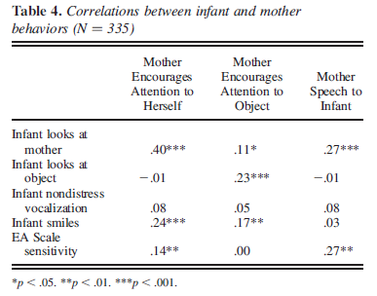
Correlations between Behaviors
Raw frequencies of mother and infant behaviors
Does not consider contingencies
Notes:
-Looked at correlations to see whether mothers and infants who engaged in a given behavior more frequently had partners who engaged in a complementary behavior more frequently.

Slide 29
Contingency of Mother Behaviors
Infant Action
Odds Ratio (+3 secs)
Maternal Reaction
Looks at Mother
8.5***
Encourage attention to mother
0.8**
Looks at Object
1.3**
1.8***
4.5***
Encourage attention to object
3.1***
Nondistressed Vocalization
2.1***
1.0 ^{ns}
1.5*
1.1**
Smiles
1.4***
Speech to Infant
1.7***
ORs >1 = more likely to occur after infant action than at other times
ORs 0 - 1 = less likely
Notes:
-ORs > 1: indicate that the mother’s behavior was more likely to begin within 3s of the infant behavior than at other times
ORs = 0-1: indicate less likelihood
Here you can see each possible pairing of infant behavior followed by mother behavior
-Computed odds ratios to reflect likelihood of each behavior occurring within 3 seconds of the infant behavior
-Only one OR was not significant, meaning that it was just as likely that mothers responded to nondistress vocalization by encouraging attention as by any other behavior
-Only one OR was <1 (and sig), indicating that it was significantly unlikely that mothers responded within 3s of the onset of their infants looking at an object by encouraging attention to themselves

Slide 30
Contingency & Sensitivity
Infant Action
Correlation of Odds Ratio with maternal sensitivity
Maternal Reaction
Looks at Mother
Encourage attention to mother
More contingent speech to looking at mother = less sensitive
Looks at Object
More contingent encouragement to looking at mother = more sensitive
Encourage attention to object
Nondistressed Vocalization
Smiles
Speech to Infant
Notes:
Zero-order correlations cannot detect non-linear relationship ,so instead the authors used spline regressions

Slide 31
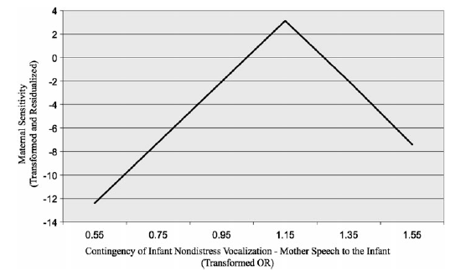
Contingency & Sensitivity
OR = 1.17
When maternal speech contingency odds are beyond just significantly >1, are rated as less sensitive
When maternal speech to infant is contingent on infant nondistress vocalizations, mothers are rated as more sensitive
Notes:
-Masking of nonlinear associations:
-Using bivariate scatterplots with LOWESS “smoothers” found that some types of maternal contingency showed linear relationships with sensitivity that differed in slope before and after a given point (or “knot”) on the contingency continuum
-Used spline regressions to see whether changes in slopes at knots were significant and, if significant, to obtain linear rates of change leading to and following the not
UNTIL THE ODDS OF RESPONDING ARE JUST SIGNIFICANTLY GREATER THAN 1

Slide 32
Contingency & Sensitivity
Infant Action
Shows knots with change in slope before and after
Maternal Reaction
Looks at Mother
Encourage attention to mother
Looks at Object
Encourage attention to object
Nondistressed Vocalization
Smiles
Speech to Infant

Slide 33
Contingency of maternal responses & perceived maternal sensitivity
Contingency analyses better represent how coordinate infant and mother behaviors are than correlation analyses (92% vs 50%)
For most infant-mother behavioral pairings, contingency odds ratios just greater than 1 were deemed “optimally sensitive”
Developmental Implications: mastering contingencies helps development
Innate “contingency detection module”?
Imperfect maternal contingency may be adapative
Clinical implications: parenting
Withdrawn and vigilant parenting = nonoptimal child development
Notes:
In other words, greater contingency did not translate into greater sensitivity ratings in a “dose-response” manner; rather, past a certain threshold of contingency, mothers who were more contingent received lower sensitivity ratings
proposed an innate “contingency
detection module,” which analyzes the temporal conditional
probabilities affording infants the capacity to detect contingent
relations in the environment.

Slide 34
Discussion Questions
Caregiver Characteristics: How might the contingencies and their relationship to sensitivity change if:
Considered Psychopathology: maternal depression
Had an ethnically diverse sample: cultural and contextual factors (e.g., race, SES, neighborhood). E.g., trauma and hypervigilance as a protective parenting strategy to protect children from racial oppression
Looked at nonmaternal caregivers: father’s and grandparents
Considered who is the non-primary caregiver: intergenerational family households or non-familiar caretakers
Methods Questions
Would a head camera or maternal recording change the interaction?
Data analysis: why one knot and only two slopes? Is there a better fitting model? Sweet spot vs. sweet zone?
Future Application
Does the “some is more” finding predict later childhood outcomes? Which outcomes do we think would be impacted?
Is ideal responsivity, still ideal across the child’s lifespan (middle and high school)
Can we use knowledge of contingencies to inform caregiver interventions. What would that look like? And what would be the target – maternal behavior or infant attachment?

Slide 35
The Role of Maternal Responsiveness
A curvilinear relationship?
Past studies suggest that both over- and under-contingency to young infants may negatively impact development
Intermediate levels of contingency → secure attachment
Over-/under-contingency → insecure attachment
However, these studies have focused on the relationship between responsiveness and child outcomes
The current study seeks to understand how maternal responsiveness is related to independent ratings of global maternal sensitivity

Slide 36
Current Study Aims & Hypotheses
More specifically the current study seeks to address the following:
How does maternal contingency vary by different responses and to different infant behaviors?
How can levels of maternal contingency be quantified in ways that go beyond the usual qualitative attributions (e.g. “low”/”mid-range”/”high”)?
What quantitative levels of maternal contingency are judged to be optimally sensitive?
Hypothesis:
Maternal over- and undercontingency will be rated as generally less sensitive, whereas levels surrounding significant maternal contingency will be rated optimally sensitive.

Slide 37
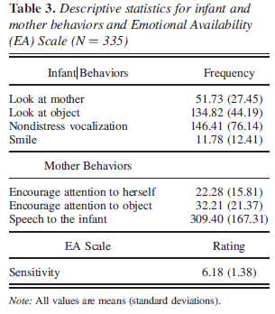
Method
Coding of maternal sensitivity:
The same recordings were evaluated by independent coders
Sensitivity Scale from the Emotional Availability Scales: Infancy to Early Childhood Version (EA Scales)
Maternal sensitivity scored from 1 (highly insensitive) to 9 (highly sensitive)
Notes:
-EA scales provide a global assessment of parenting quality based on observations and ratings of parent-child interactions
-Looked at reliability of ratings for a subset of both types of coding
-Table 3 shows frequencies of each type of behavior as well as average sensitivity rating
-Mother speech = highest
-Infant smile = lowest
-EA ratings ranged from 2-8.5

Slide 38
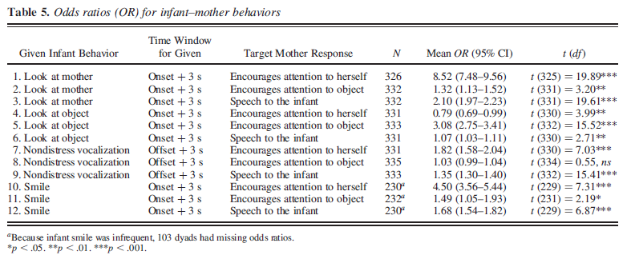
Contingency of Mother Behaviors
ORs > 1: indicate that the mother’s behavior was more likely to begin within 3s of the infant behavior than at other times
ORs = 0-1: indicate less likelihood
Notes:
-Here you can see each possible pairing of infant behavior followed by mother behavior
-Computed odds ratios to reflect likelihood of each behavior occurring within 3 seconds of the infant behavior
-Only one OR was not significant, meaning that it was just as likely that mothers responded to nondistress vocalization by encouraging attention as by any other behavior
-Only one OR was <1 (and sig), indicating that it was significantly unlikely that mothers responded within 3s of the onset of their infants looking at an object by encouraging attention to themselves

Slide 39
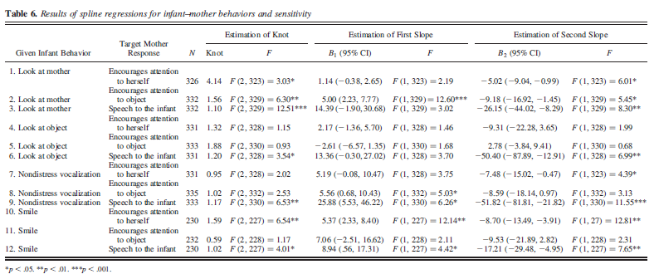
Contingency & Sensitivity
Notes:
-There is A LOT going on in this table, BUT basically we are looking at:
-the placement of the knot along the X axis (contingency OR)
-whether the know was significant
-the slope before and the slope after the knot
-whether those slopes are significant
-11 of the 12 pairings showed the general pattern from the previous slide
-take home point: for many of the pairings, the mother’s sensitivity rating increased up to a certain OR and then decreased thereafter

Slide 40
Summary
Current study sought to better understand the relationship between the contingency of maternal responses and perceived maternal sensitivity
For most infant-mother behavioral pairings, contingency odds ratios just greater than 1 were deemed “optimally sensitive”
In other words, greater contingency did not translate into greater sensitivity ratings in a “dose-response” manner; rather, past a certain threshold of contingency, mothers who were more contingent received lower sensitivity ratings

Slide 41
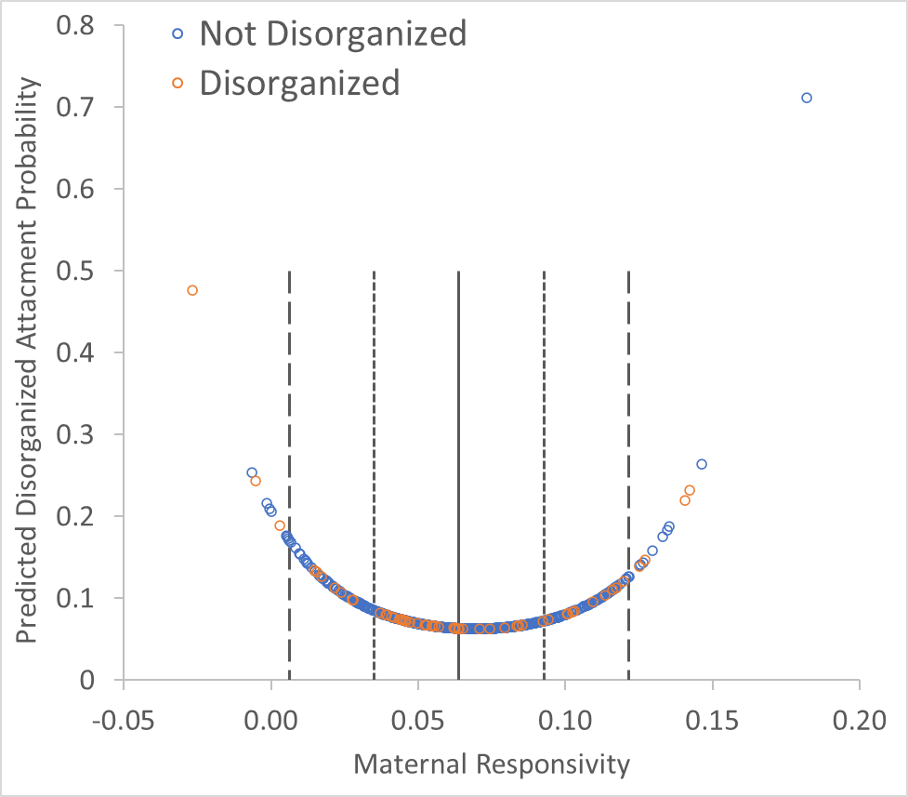
Responsivity → Disorganization: A u-shaped curve
Mitsven & Prince et al., 2021
Predicting disorganized attachment
Predictors | B (SE) | p-value | Exp (B)
Constant | -1.35 (2.13) | .527 | .26
Maternal responsivity (linear) | -39.28 (13.04) | .003 | .00
Maternal responsivity (quadratic) | 283.50 (89.95) | .002 | 2.1325E+123
Maternal auto-correlation | -0.79 (2.43) | .745 | .45
Infant responsivity | -0.61 (3.65) | .867 | .54
Infant auto-correlation | 0.85 (1.35) | .528 | 2.34
Disorganized attachment coded 1 (vs. 0).

Slide 42
Is security a ‘vaccination’?
Most competent 3-yr-olds have both secure attachment (at 15 mo) & (relatively) high-sensitive mothering (at 24 mo)
NICHD Study of Early Child Care
Additional influence of sensitivity
Insecurely attached children who subsequently experienced high-sensitive mothering significantly outperformed secure children who subsequently experienced low-sensitive mothering.
Belsky, J. and R. M. P. Fearon (2002). "Early attachment security, subsequent maternal sensitivity, and later child development: Does continuity in development depend upon continuity of caregiving?" Attachment & Human Development 4(3): 361-387.

Slide 43
Understanding development
Security
Sensitivity
Outcome
Time

Slide 44
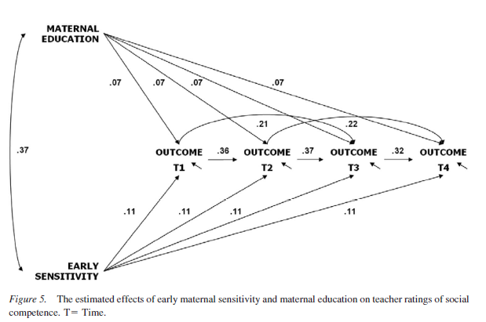
Sensitivity → social competence
through age 15
1st look
Fraley, R. C., Roisman, G. I., & Haltigan, J. D. (2013). The legacy of early experiences in development: Formalizing alternative models of how early experiences are carried forward over time. Dev Psychol, 49(1), 109-126.

Slide 45
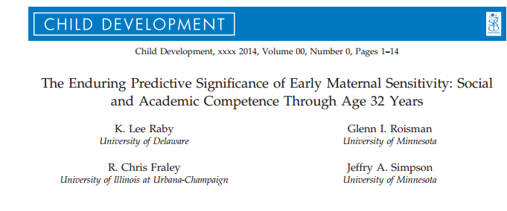
Maternal sensitivity

Slide 46
Are the effects of early relationship experiences enduring or transient?
Two competing theoretical models
Enduring Effects
Revisionist
Difference: patterns of association
Stable across time
Increasingly smaller association
Notes:
Enduring effects: early relationship experiences organize early developmental adaptation AND continue to shape adjustment across development via mechanisms consolidated during early childhood
Revisionist: early relationship experiences have direct effect on children’s early development but only indirectly associated with subsequent adaptation due to stability of adjustment over time.

Slide 47
Are the effects of early relationship experiences enduring or transient?
Enduring Effects Model
Early relationship experiences organize early developmental adaptation and continue to shape adjustment across development
Revisionist Model
Early relationship experiences directly effect early childhood development but then only indirectly effect subsequent adaptation

Slide 48
Purpose of Study
Duplicate findings of Fraley et al., 2013
That early maternal sensitivity has lasting effects on children’s social and cognitive development
Extend findings of Fraley et al., 2013
Does early maternal sensitivity’s effects extend into adulthood?
Is there a more complex developmental process at work?
Do covariates account for potential enduring effects?

Slide 49
Minnesota Longitudinal Study of Risk and Adaptation (MLSRA)
N = 243
45% female, 65% White/Non-Hispanic
Maternal sensitivity
Feeding observations (3 + 6 mo.)
Play interactions (6 mo.)
Problem-solving and Teaching tasks (24 + 42 mo.)
Social Competence
Teacher-rated competence with peers during
Kindergarten
Grades 1-3
Grade 6
Age 16
Academic Competence
Peabody Individual Achievement Test
Grades 1-3 and 6
Woodcock-Johnson Tests of Achievement
Age 16

Slide 50
Outcomes
Competence in Romantic Relationships
Semi-structured interview regarding recent romantic relationship history
Ages 23 and 32
Educational Attainment
6-point scale (no GED or high school diploma – a post-baccalaureate degree)
Ages 23, 26, 28, and 32

Slide 51
Results: Enduring Effects
Maternal Sensitivity
Social competence:
ΔΧ² = 17.18, p <.001
Academic Competence:
ΔΧ² = 15.03, p <.001
Time 1
Time 2
Time 3
Time 4
Time 5
Time 6
Social and Academic Competence

Slide 52
Results: Transactional
Maternal Sensitivity
Social competence:
ΔΧ² = 11.54, p <.001
Academic Competence:
ΔΧ² = 9.96, p =.002
Time 1
Time 2
Time 3
Time 4
Time 5
Time 6
Social and Academic Competence at Different Times

Slide 53
Results: Covariates
Maternal Sensitivity
Social competence:
ΔΧ² = 1.72, p = .19
Social and Academic Competence at Different Times
Time 1
Time 2
Time 3
Time 4
Time 5
Time 6
Enduring effects of:
Gender**
Maternal Education**
Socioeconomic Status
Ethnicity
Covariates
Notes:
Child sex, child ethnicity, maternal education, maternal socioeconomic status

Slide 54
Results: Covariates
Maternal Sensitivity
Academic Competence:
ΔΧ² = 9.96, p =.002
Social and Academic Competence at Different Times
Time 1
Time 2
Time 3
Time 4
Time 5
Time 6
Enduring effects of:
Gender*
Maternal Education*
Socioeconomic Status*
Ethnicity
Covariates
Notes:
Child sex, child ethnicity, maternal education, maternal socioeconomic status

Slide 55
Results: Transactional + Covariates
Maternal Sensitivity
Academic Competence:
ΔΧ² = 3.96, p <.05
Social and Academic Competence at Different Times
Time 1
Time 2
Time 3
Time 4
Time 5
Time 6
Enduring effects of:
Gender*
Maternal Education*
Socioeconomic Status
Ethnicity
Covariates
Notes:
Child sex, child ethnicity, maternal education, maternal socioeconomic status

Slide 56
Sensitivity does not predict social competence (w covariates)
Maternal Sensitivity
Social Competence:
ΔΧ² = 0.82, p =.37
Social and Academic Competence at Different Times
Time 1
Time 2
Time 3
Time 4
Time 5
Time 6
Enduring effects of:
Gender**
Maternal Education**
Socioeconomic Status
Ethnicity
Covariates
Notes:
Child sex, child ethnicity, maternal education, maternal socioeconomic status

Slide 57
Sensitivity → Academic competence (with covariates)
Maternal Sensitivity
Why?
Academic Competence:
ΔΧ² = 3.96, p <.05
Social and Academic Competence at Different Times
Time 1
Time 2
Time 3
Time 4
Time 5
Time 6
Enduring effects of:
Gender*
Maternal Education*
Socioeconomic Status
Ethnicity
Covariates
Notes:
Child sex, child ethnicity, maternal education, maternal socioeconomic status

Slide 58


What about attachment in adulthood? AAI

Slide 59
How Speakers are Categorized
As Autonomous (secure), Dismissing (avoidant), or Preoccupied (resistant)
And, independently, as Unresolved/Disorganized
Not based on experiences themselves
But on speaker’s current relationship to the experiences
how they’ve processed their past
Based on the coherence of their discourse

Slide 60
Validity of AAI
Classifications are stable
2 months, 3 months, 1.5 years
Not related to IQ measures
6 of 7 studies
Discourse style relates to attachment
not interviews about job
Machine learning shows some ability to distinguish adult attachment in AAI

Slide 61
Parent-Infant Attachment Correspondence
Meta-analysis of 13 studies using three major categories
75% secure vs. insecure agreement (K=.49)
70% three-way agreement (K=.46)
Prebirth AAI show 69% three-way agreement (K=.44)
Bakermans-kranenburg, M. J. & Vanijzendoorn, M. H. (1993). A Psychometric Study of the Adult Attachment Interview - Reliability and Discriminant Validity. Developmental Psychology, 29, 870-879.

Slide 62
Parent-Infant Correspondence

Slide 63
Breaking the Link
Parental attachment is not formed by past experiences but by current orientation to past.
Supportive experiences with a partner, friend or therapist can allow for earned autonomy in the face of experiences that would otherwise be associated with insecurity.

Slide 64
Interview
Interview a partner about one attachment figure focusing on questions 2 through 4
Each person analyzes their own responses
no comments form partner
Only share what you want to share

Slide 65
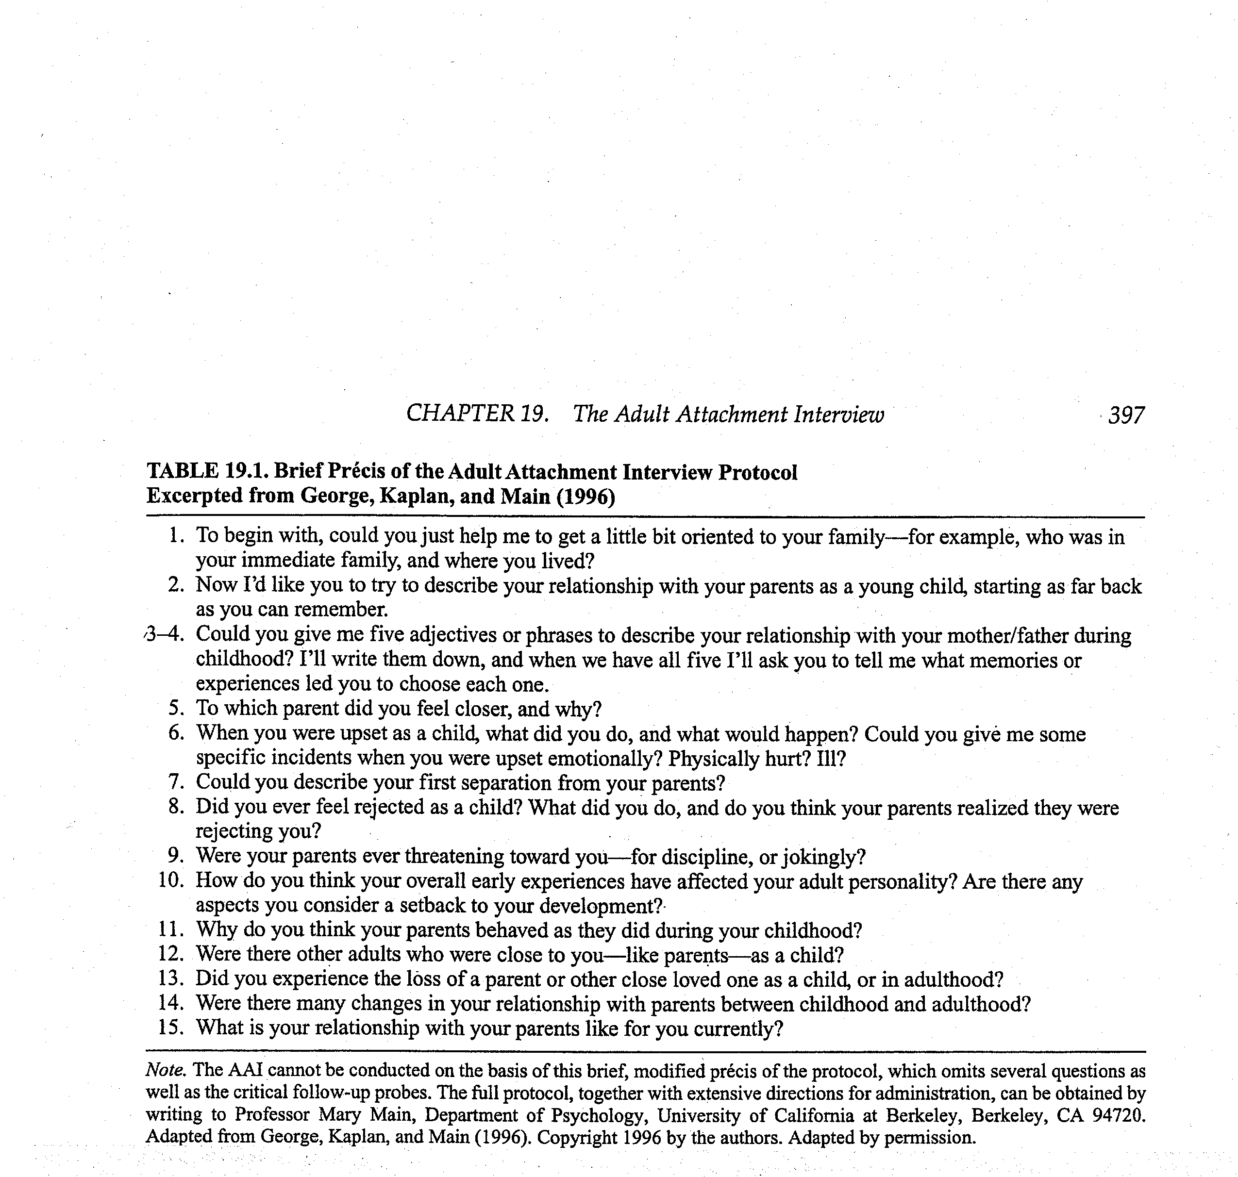
Adult Attachment Interview

Slide 66
How to Think About What You’ve Said
Scales associated with autonomous category
coherence, metacognitive monitoring
Scales associated with dismissing category
Idealization of attachment figures, insistence on lack of memory for childhood, dismissal of attachment-related experience/relationships
Scales associated with preoccupied category
anger expressed toward attachment figure, passivity/vagueness in discourse

Slide 67
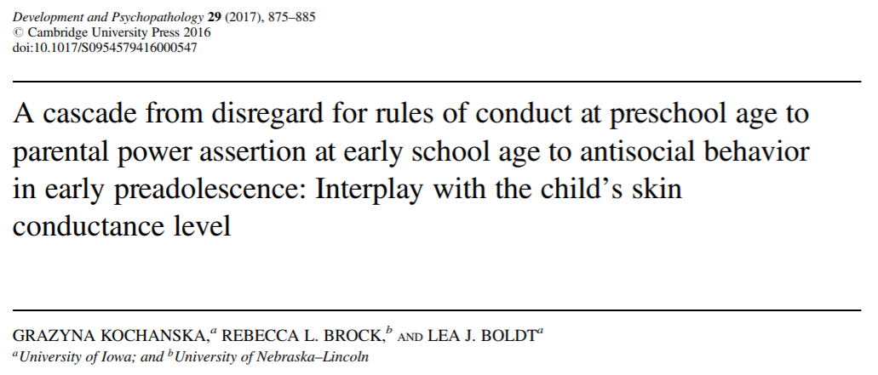
Beyond sensitivity: power and…
Notes:
A study implementing a multilevel developmental approach. Testing their cascade model with community families (mothers, fathers, and children) followed longitudinally from preschool age to early preadolescence.

Slide 68
Background
High levels of disregard for rules in childhood may be early signs of a trajectory toward disruptive conduct problems.
Link between children’s disregard for conduct rules and future antisocial behavior may be mediated through harsh or power-assertive discipline.
Parental power assertion and antisocial behavior are closely linked.
Little is known about the role of children’s SCL as a potential moderator.
A conditional process model: developmental cascade from early disregard for rules to parental power assertion to future antisocial behavior is expected to occur for children who have low skin conductance level (SCL).
Notes:
The child’s disregard for rules or failing to feel discomfort after misbehaving or engaging in rule breaking is an important aspect of oppositional, disruptive conduct problems. This trajectory begins early and is relatively stable.
that parents deploy toward children who display a high level of disregard for rules.
Few studies have examined children’s SCL as a potential moderator of the process leading from early disregard for rules of behavior, to parental power-assertive discipline, to future antisocial behavior problems. Such children presumably fail to respond to subtle, gentle levels of parental discipline, in contrast to children with high SCL.
They proposed a conditional process model, in which the developmental cascade from early disregard for rules of behavior to parental power assertion to future antisocial behavior is expected to occur for children who have low skin conductance level.
SCL is a measure of the functioning of the autonomic nervous system that reflects variations in the ease with which electrical current passes across the skin due to fluctuations in sweat gland activity.

Slide 69
Methods
Participants
Two-parent families of typically developing infants (N = 102)
Measures
Children’s disregard for rules of conduct at 4.5 years
Coding: avoiding gaze, facial tension, bodily tension, and overall distress
Parental power-assertive discipline at 5.5-6.5 years
Coding: no interaction, social exchange, gentle guidance, control, forceful control, physical assertive, and physical forceful
Children’s SCL at age 8
Children’s antisocial behavior at ages 10 and 12
Parent report
Notes:
Children’s disregard for rules of conduct at 4.5 years was observed in multiple paradigms (children’s lack of concern or remorse following rule violations, children’s disregard for parents’ rules, children’s disregard for another adult’s rules)
Avoiding gaze (when the child looked away, downward, or askance)
Facial tension (when the child displayed the following: twisting or biting lips, raising/furrowing eyebrows, squinting eyes, or crinkling nose)
Bodily tension (when the child showed squirming, backing away, hanging head down, hunching shoulders, hugging self, or covering face with hands)
Global ratings and physical techniques

Slide 70
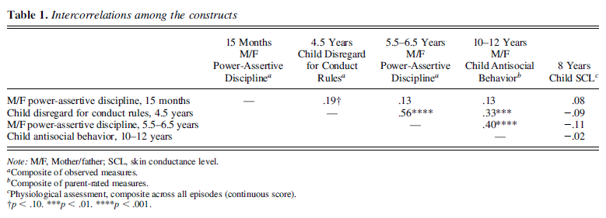
Child disregard, parental power, child antisocial associated
Notes:
Children’s stronger disregard for rules of conduct at 4.5 years was associated with more parental power-assertive discipline at ages 5.5-6.5 years and with more parent-rated antisocial behavior at ages 10-12 years.
Parent’s power-assertive discipline at 5.5-6.5 years was also positively associated with parent-rated antisocial behavior at ages 10-12 years.

Slide 71
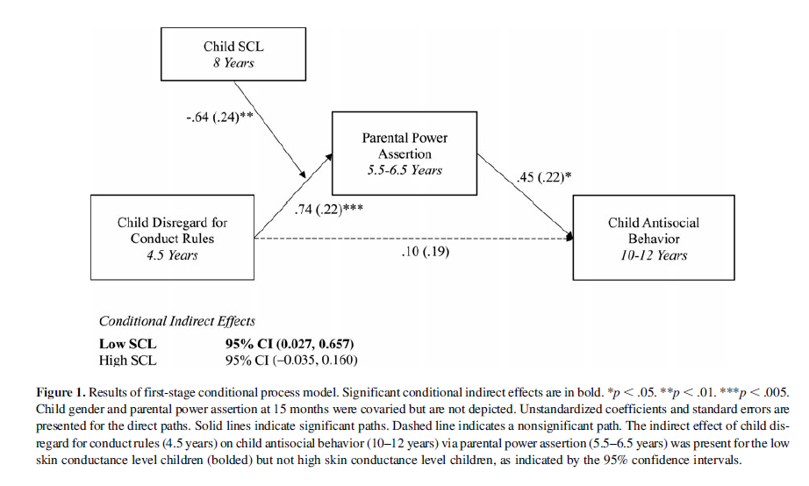
Child disregard → parental power → child antisocial for low SCL
Children with high SCL may respond positively to subtle parental socialization before the pressure reaches a high level.
Notes:
This model represents the conditional indirect effect of child disregard for conduct rules at 4.5 years on child antisocial behavior at 10-12, as mediated by parental power assertion at 5.5-6.5 years, only for the low-SCL children, but not for the high-SCL children.
Complementary analyses of this model using a continuous measure of SCL also showed this conditional indirect effect from disregard for conduct rules to parental power to antisocial behavior was present at very low SCL (1.5 SD below the mean), low SCL (1 SD below), and average SCL. But not at high SCL (1 SD above) or very high SCL (1.5 SD above)

Slide 72
Explanation
Early disregard for rules elicited increased parental power assertion, potentially due to those low-SCL children’s history of failing to respond to subtle, gentle punishment, and the increased power assertion resulted in future antisocial behavior.
Children with high SCL presumably respond positively to subtle parental socialization before the pressure reaches a high level.
Notes:
Important to understand under what conditions and through what processes early disregard for rules may predict future behavior problems.
, preventing them from future antisocial behavior.

Slide 73
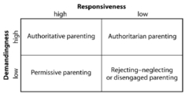
Parenting Styles
Baumrind’s Model of Parenting Styles

Slide 74

American Academy of Pediatrics recommends against spanking as it may be “potentially deleterious to children”

Slide 75
Spanking=BAD
American Academy of Pediatrics recommends against spanking as it may be “potentially deleterious to children”
Gershoff 2002: Meta-analysis of 88 studies shows spanking related to 10/11 outcomes
New meta-analyses will be discussed in Gershoff & Grogan-Kaylor (2016) article
Garcia; Shaffer | MacKenzie et al., 2013

Slide 76
Limitations of Prior Research
Few longitudinal studies
Missing measures of stress & SES
No study of paternal spanking
Little study of effects of spanking on children’s cognitive development
Shaffer | MacKenzie et al., 2013
Notes:
Longitudinal: for temporal sequencing of spanking – outcomes
Not extensive inclusion of variables of other stressors, which could account for mixed results relating to spanking and outcomes across ethnicities
No focus on paternal spanking – don’t know whether parents making different parenting decisions or whether they have different effects
Most research on aggressive behavior, little on cognitive development

Slide 77
Methods: Sample
Fragile Families and Child Well-Being Study
~4200 children from 20 U.S. cities born between 1998 and 2000 in medium to large cities
1933 families for externalizing behavior analyses
1532 families for receptive vocabulary analyses
Included families: may have more resources and/or be more stable at baseline than excluded families
Remained a “disadvantaged urban sample”
Garcia; Shaffer | MacKenzie et al., 2013
Notes:
FFCW: longitudinal birth cohort drawn from 20 cities, representative of children born between 1998-2000 in medium to large US cities
Only included families that had data from the Child Behavior Checklist and Peabody Picture Vocabulary Test at age 9
Those included differed in some ways from those excluded (e.g., excluded more likely to be first child and have low birth weight)

Slide 78
Methods: Measures – Primary Predictor
Maternal & Paternal Spanking
“In the past month, have you spanked (child) because (she/he) was misbehaving or acting up?”
0 times
< 1 time/week
> 2 times/week
No spanking
Low Frequency Spanking
High Frequency Spanking
Shaffer | MacKenzie et al., 2013

Slide 79
Methods: Measures – Outcomes
Child Externalizing Behavior
Age 9: Aggression & Rule-Breaking subscales of CBCL
Age 3: Aggression & Destructive subscales of CBCL (ctrl)
Child Receptive Vocabulary
Age 9: Peabody Picture Vocabulary Test (PPVT)
Age 3: PPVT (ctrl)
Shaffer | MacKenzie et al., 2013

Slide 80
Methods: Measures – Child and Family Control Variables
Category | Variable
Child Risk Factors | Gender; age; low birth weight; if first born; infant temperament
Maternal and Family Characteristics | Maternal age; marital structure; mother’s race/ethnicity; maternal education; household income; mother foreign-born; mother’s residence at age 15; maternal employment, number of adults and children in home
Prenatal Risks | Late onset of prenatal care; risky health behavior; IPV; birth father’s supportiveness
Maternal Risk Factors | Mother’s parenting stress; mother depression or GAD dx; mother’s impulsivity; mother’s cognitive level; mother’s frequency of cognitively stimulating activities with child
Rumper | MacKenzie et al., 2013
Notes:
Four models reported, ascending in rigor of control variables. First model had no control vars, second included these vars for control

Slide 81
Prevalence of Spanking
Age 3
Age 5
Mothers
Spanking child ≥2/week
Spanking child <2/week
No Spanking
Fathers
Shaffer | MacKenzie et al., 2013
Notes:
Use of any spanking in the past month decreased from age 3 to age 5

Slide 82
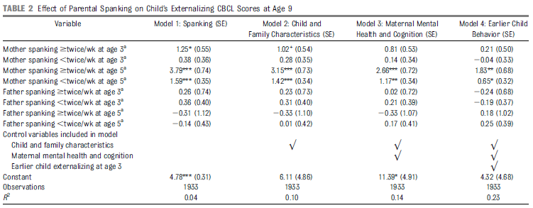
Results: Spanking and Child Externalizing Problems
Shaffer | MacKenzie et al., 2013
Notes:
When only using spanking to predict CBCL outcomes, maternal spanking at 3 and 5 years of age significantly positively related to children’s externalizing problems at age 9
As control variables become more stringent, impact of spanking attenuated, but still significant
Lastly, when early childhood externalizing behavior controlled for in model, maternal spanking at any frequency still significantly relates to later externalizing behavior

Slide 83
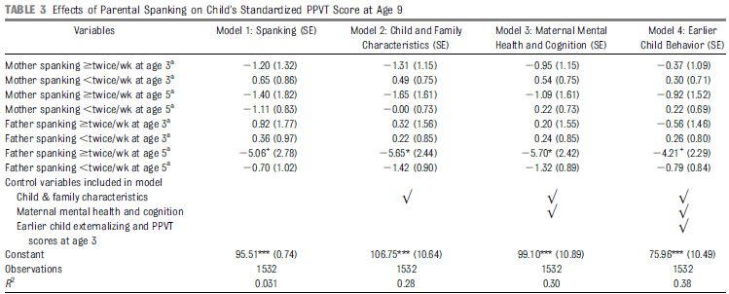
Results: Spanking and Child Receptive Vocabulary
Shaffer | MacKenzie et al., 2013
Notes:
In contrast:
When only using spanking to predict PPVT outcomes, no relationship between spanking and this measure of cognitive development
As control variables become more stringent, father high-frequency spanking inversely related to child receptive vocabulary
Lastly, when early receptive vocabulary controlled for in model, paternal high frequency spanking dropped to only marginal significance.

Slide 84
Conclusions
Maternal spanking at age 5 predicts children’s externalizing behavior at age 9
Extensive control variables increases confidence in effect
High-frequency paternal spanking at age 5 affects children’s verbal capacity at age 9
Effects hold across genders and race/ethnicity
Rumper| MacKenzie et al., 2013
Notes:
Recall effect of father’s spanking fell to marginal significance when no control vars and again when all control vars added and earlier PPVT score added
Reactions: self, surprised b/c heard evidence of positive outcomes for spanking among AA especially among dangerous neighborhoods.
Some evidence suggests temporal relationship between spanking & temperament (aggression/antisocial behavior) differs b/t European American & African Americans – AA antisocial elicited spanking; EA antisocial elicited & contributed to antisocial behavior (more reciprocal)

Slide 85
Discussion
Are there any other variables that should have been included in this analysis?
Any that could have been left out?
Issues with conclusion about spanking→ verbal capacity?
Are controls used sufficient to draw this conclusion?
Differences between groups AKA null race/ethnicity interaction?
Other possible moderating factors?
Garcia | MacKenzie et al., 2013

Slide 86
Sara Wigderson

Slide 87
Background
4 meta-analyses have been conducted recently with each coming to varied conclusions
Goals of this meta was to focus on two criticisms of previous metas:
1) Is spanking associated with negative outcomes, or is it harsh or abusive methods that impact children?
2) Are associations between spanking and adverse child outcomes only found in studies with weak methods (e.g., cross-sectional)?
For this meta, physical punishment = noninjurious, open-handed hitting with the intention of modifying child behavior
Wigderson | Gershoff & Grogan-Kaylor, 2016

Slide 88
Method
75 studies met inclusion criteria
111 individual effect sizes representing over 160k children
7 variables coded for moderator analyses
1) study design
2) measure of spanking
3) index of spanking
4) independence of the raters
5) time period in which spanking was done
6) the country in which the study was conducted
7) child age at time of spanking
Wigderson | Gershoff & Grogan-Kaylor, 2016

Slide 89
Results
Effect sizes were consistent
Out of 111 studies, 102 demonstrated detrimental child outcomes
78 of these were statistically significant
Only 1 beneficial outcome was significant
99% of sig. outcomes were detrimental
Wigderson | Gershoff & Grogan-Kaylor, 2016

Slide 90
Spanking significantly adversely associated with 13/17 outcomes
Childhood:
low moral internalization, aggression, antisocial behavior, externalizing behavior problems, internalizing behavior problems, mental health problems, negative parent– child relationships, impaired cognitive ability, low self-esteem, and risk of physical abuse from parents
Adulthood:
adult antisocial behavior, adult mental health problems, and with positive attitudes about spanking
Wigderson | Gershoff & Grogan-Kaylor, 2016

Slide 91
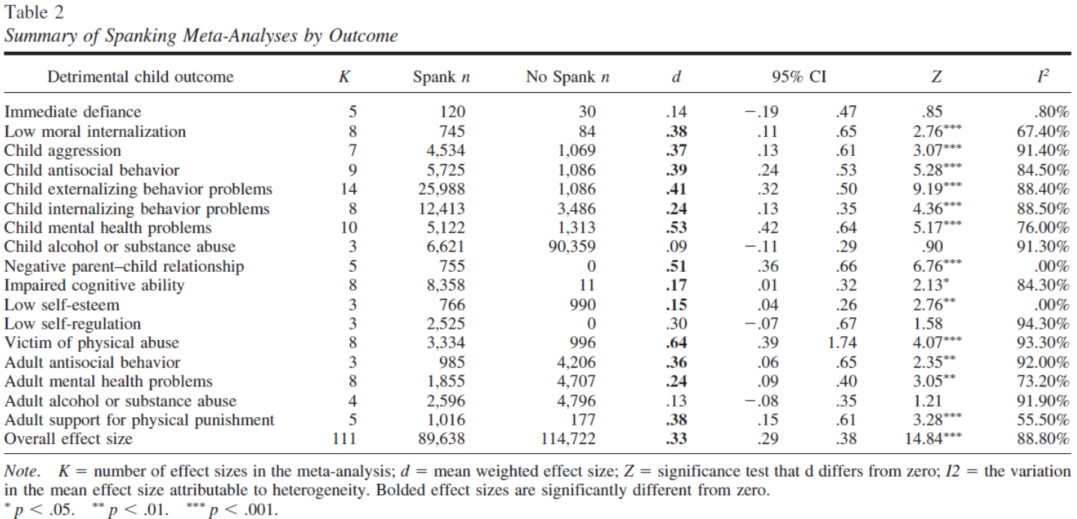
Spanking outcome meta-analyses
Wigderson | Gershoff & Grogan-Kaylor, 2016

Slide 92
Spanking and physical abuse
7 studies (10 effect sizes) that examined both spanking and physical abuse
In 3 cases, effect size for spanking was larger than physical abuse
Overall effect sizes for both demonstrated detrimental outcomes (physical abuse = .38, spanking = .25)
Wigderson | Gershoff & Grogan-Kaylor, 2016

Slide 93
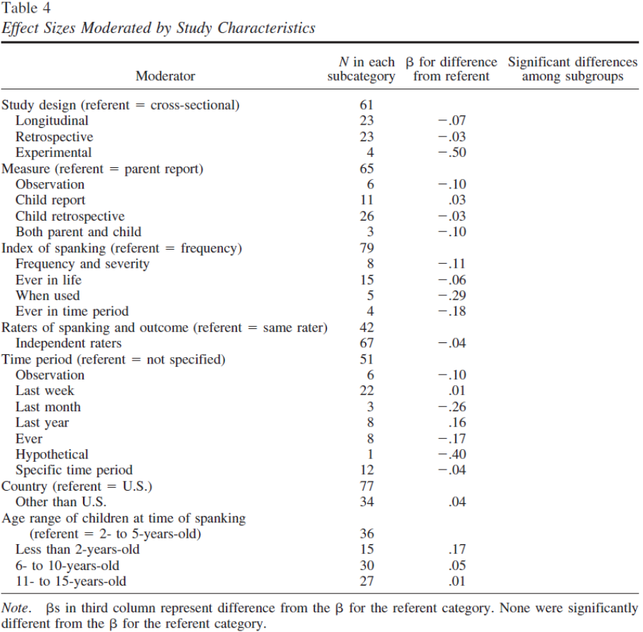
Table 4
None were significant, indicating that effect sizes did not vary by study characteristics!
Wigderson | Gershoff & Grogan-Kaylor, 2016

Slide 94
Discussion
Thoughts on moderator analyses?
What does it mean for the field that longitudinal and cross-sectional studies did not produce different effect sizes?
Weaknesses of the article:
Were they overly selective in their inclusion criteria?
Publication bias?
What steps can be taken to inform parents and the public of these results?
Wigderson | Gershoff & Grogan-Kaylor, 2016

Slide 95
Huston & Aronson (2005)
Associations between mothers’ time in employment and mother-child relationship & child development outcomes
Problems with time in out-of-home care as proxy for time with mother?
“Employed women apparently compensate for their absence by spending more time with their children during nonwork hours
(Easterbrooks & Goldberg, 1985; Hill & Stafford, 1985; Nock & Kingston, 1988; Zaslow, Pederson, Suwalsky, Cain & Fivel, 1985).”
Notes:
“time may not be the cause of maternal
sensitivity and inclination to interact with the child
but may instead be a reflection of these maternal
characteristics.”

Slide 96
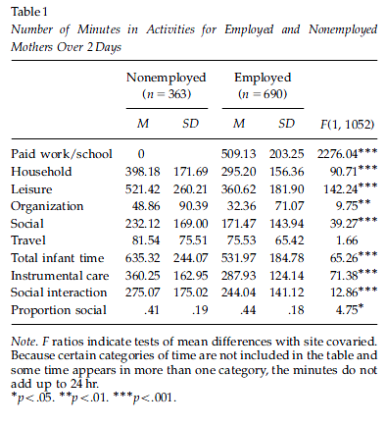
Greater infant time (but not proportion social) for nonemployed)

Slide 97
Maternal characteristics associated with time use
Mothers who spent more total time with children were:
Older, White, higher psychological adjustment, had fewer children, lower incomes, high separation anxiety, believed maternal employment was not good for children
Mothers who spent more available time with children:
Older, White, higher psychological adjustment, fewer children, high separation anxiety

Slide 98
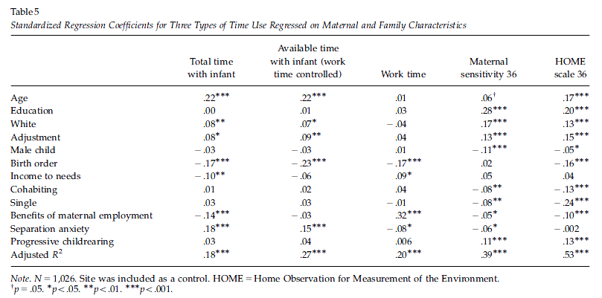
Predicting time use, sensitivity, HOME

Slide 99
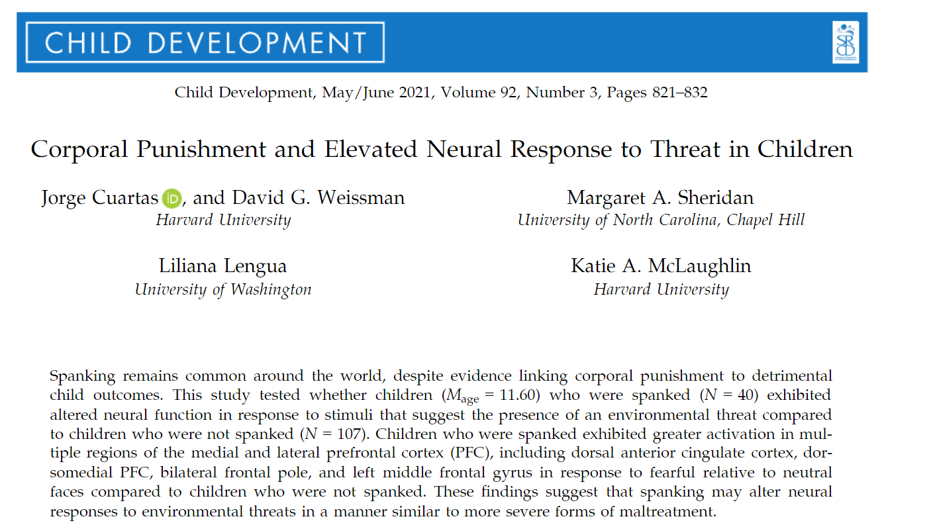
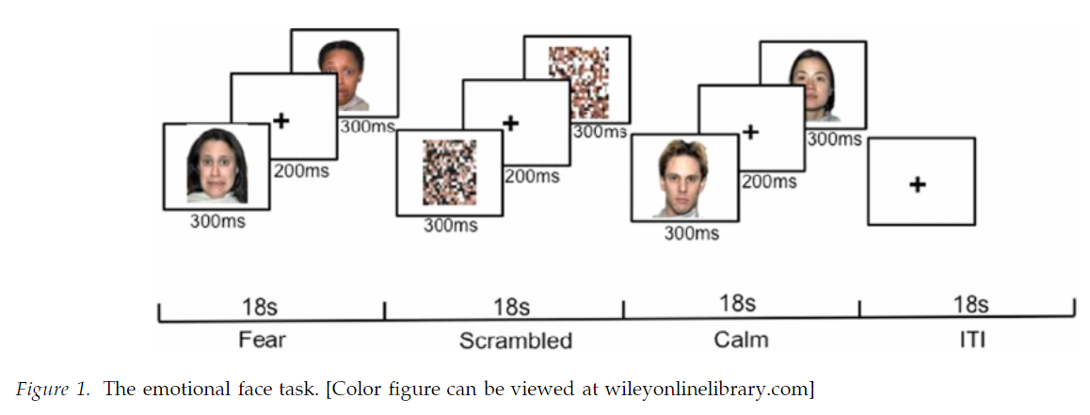

Slide 100
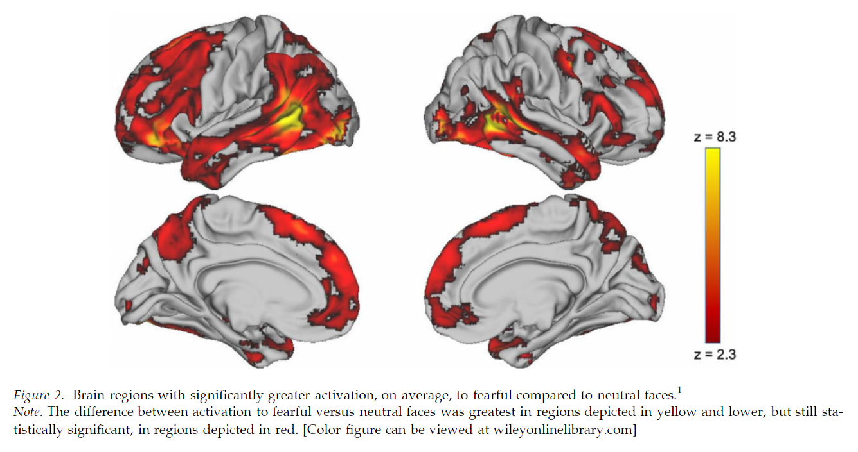
Overall: Fear > Neutral areas

Slide 101
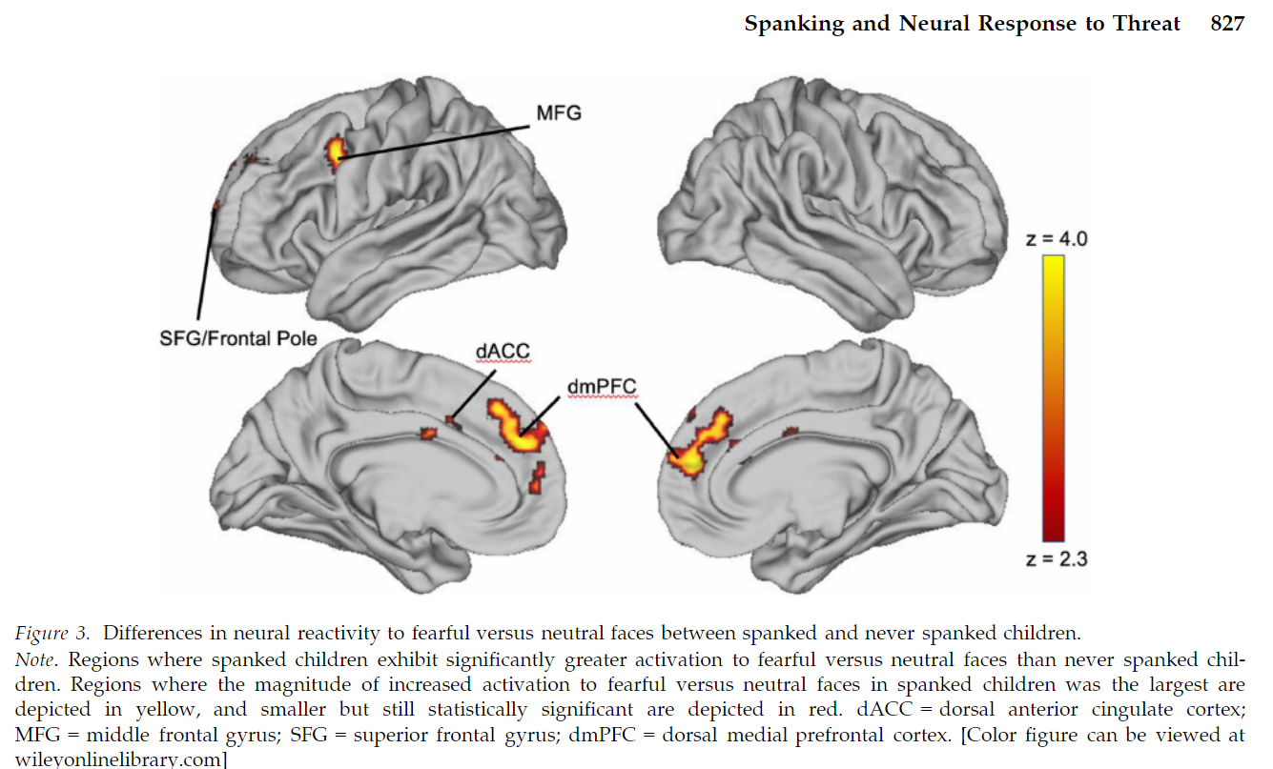
Spanked vs. not-spanked: Fear vs. neutral
Notes:
The MFG is frequently engaged during effortful attempts to regulate emotional responses, such as when using cognitive
reappraisal (Goldin, McRae, Ramel, & Gro ss, 2008; Kanske, Heissler, Schonfelder, Bongers, & Wessa,
2010; Silvers, Weber, Wager, & Ochsner, 2014).
Children who have been exposed to violence recruit regions of the dorsolateral PFC more during cogni-
tive reappraisal of negative emotion than those who have never encountered violence, particularly
during adolescence (Jenness et al., 2020; McLaugh-lin et al., 2015). Neutral faces are ambiguous stim-
uli, and are often interpreted as negative by children (Tottenham et al., 2009).

Slide 102
Parenting Styles
Baumrind’s Model of Parenting Styles

Slide 103
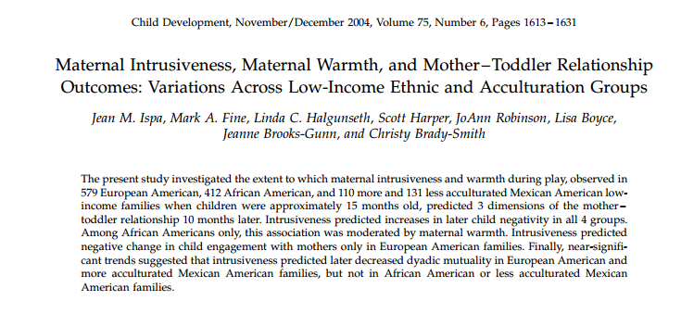

Cultural differences in association between intrusiveness and warmth at 15 months?
(Ispa et al., 2004)

Slide 104

Sensitive Structuring

Slide 105
Control and warmth -- central dimensions of parenting
Intrusiveness =
a constellation of insensitive, interfering parenting behaviors
rooted in mothers’ lack of respect for their infants’ autonomy.
Warmth =
mother’s physical and verbal expressions of love, attentiveness, and respect or admiration for the child.
Intrusiveness generally associated with negative developmental outcomes
But mixed findings…..Why?
Ispa et al. (2004)

Slide 106
Maternal control and maternal warmth are central to parenting
Maternal Intrusiveness
A constellation of insensitive, interfering parenting behaviors
Dominates a child’s play agenda so that the child has little or no influence on its content or pace
Maternal Warmth
A mother’s physical and verbal expressions of love, attentiveness, and respect or admiration for the child
How do parenting practices, particularly those engaged in by the mother, affect the nature of the parent-child relationship?

Slide 107
Maternal intrusiveness: same or different meaning across cultures?
Mixed findings for maternal intrusiveness and mother-child relationship outcomes
European American
non-European American
Negative
Neutral
Positive

Slide 108
Goals
Examine the extent to which maternal intrusiveness during play at 15 months affects child negativity, child engagement, and dyadic mutuality at 25 months.
Does maternal warmth moderate the link between maternal intrusiveness and later quality of mother-child relationship?
Do these relationships differ across ethnic groups?
European American, African American, Mexican American (less acculturated), and Mexican American (more acculturated)
Notes:
Child negativity toward mother: measured the degree to which the child showed anger or dislike toward the mother
Child engagement of mother: assessed the extent to which the child interacted with the mother in a positive manner, initiating or maintaining eye contact, approaching her, and responding with positive affect to her initiations.
Dyadic mutuality: measured the mother and child as a unit. High scorers displayed synchrony, comfort, and enjoyment in their interactions with each other. They seemed to share energy, affect, goals, and perspectives.

Slide 109
Hypotheses
Maternal intrusiveness
African American, Mexican American > European American
Mexican American (less acc) > Mexican American (more acc)
Maternal intrusiveness, Maternal warmth (inverse relationship)
European American
No relationship in other ethnic groups
Maternal intrusiveness → Negative changes in relationship
European American
Not predictive in other ethnic groups
Notes:
Because past findings are limited and mixed, we posed no a priori hypotheses regarding whether maternal warmth would moderate the relations among maternal intrusiveness and negative changes in mother – toddler interaction in all ethnic groups.

Slide 110
Measures
15 & 25 month mother-child play
Coded dimensions of interest
15 months
Intrusiveness
Warmth
25 months
Child negativity
Child engagement of mother
Dyadic mutuality between mother and child

Slide 111
Method
Mother-infant pairs: European American (n = 579), African American (n = 412), less acculturated Mexican American (n = 131), more acculturated Mexican American (n=110)
10-min parent-child play sessions (15 months, 25 months)
 | 15 months | 25 months
Maternal intrusiveness | ✔
Maternal warmth | ✔
Child negativity | ✔ | ✔
Child engagement | ✔ | ✔
Dyadic mutuality | ✔ | ✔
Notes:
17 Early Head Start program sites in 16 states (all had incomes at or below the federal poverty level)
Attrition: 25.2% of total sample
AA families more likely to drop out than any of the other ethnic groups, EA more likely to drop out than either MA group
Compared those who remained in the sample at both time points with those who dropped out (to determine whether attrition posed generalizability concern): Mothers who dropped out had lower scores on warmth and were younger than those who remained in the sample. “The evidence thus suggests that attrition was not a major problem”
Mexican-American families were classified by the degree to which they were acculturated, or adapted to mainstream U.S. culture, based on the language they used most and how many generations their families had been in the U.S.
Constructs measured
Maternal intrusiveness: degree to which the mother controlled the child’s play instead of allowing for the child’s preferences.
Maternal warmth: reflected the mother’s physical and verbal expressions of love, attentiveness, and respect or admiration for the child
Child negativity toward mother: measured the degree to which the child showed anger or dislike toward the mother
Child engagement of mother: assessed the extent to which the child interacted with the mother in a positive manner, initiating or maintaining eye contact, approaching her, and responding with positive affect to her initiations.
Dyadic mutuality: measured the mother and child as a unit. High scorers displayed synchrony, comfort, and enjoyment in their interactions with each other. They seemed to share energy, affect, goals, and perspectives.
-- Also obtained a composite measure of maternal stress (to test possible explanations for primary findings)

Slide 112
Results
Group Differences
All analyses controlled for maternal age, partner status, and education
European American mothers had highest depression scores and less acculturated Mexican American mothers had lowest depression scores
European American mothers displayed less intrusiveness and more warmth than mothers in any of the other groups
Notes:
EA mothers had more education, were older, and were more likely to be living with partner than were mothers in at least one of the other groups. All analyses therefore controlled for maternal age, partner status, and education.

Slide 113
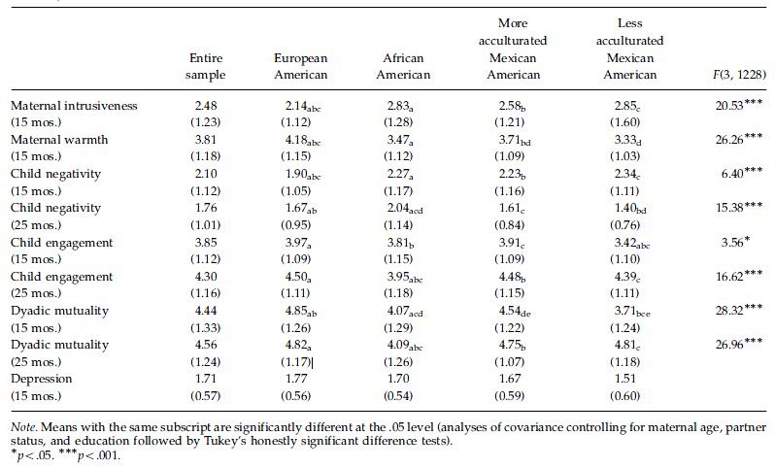
Cultural differences in parent & 15 month-old?

Slide 114
Child Negativity
Predictors of change in child-mother relationship variables between 15 and 25 months?
Child Negativity
15 month intrusiveness
15 month warmth
Culture*Intrusiveness*Warmth
EA intrusiveness predicted regardless of warmth
AA intrusiveness predicted only at low levels of warmth
Notes:
negativity at both low and high levels of warmth
(blow-warmth group5.22, po.05; bhigh-warmth group5.17,
p5.01). However, in African American families, a
moderating impact of warmth was evident. At low
levels of maternal warmth, intrusiveness predicted
25-month child negativity (b5.19, po.05). At high
levels, intrusiveness and child negativity were unrelated
(b5.12, p5.20).

Slide 115
Maternal Intrusiveness predicted child negativity in all ethnic groups
European American
intrusiveness → negative changes in child engagement
intrusiveness → decreases in dyadic mutuality
African American
intrusiveness → child negativity [only if low maternal warmth]
More acculturated Mexican American
intrusiveness → decreases in dyadic mutuality

Slide 116
Child Engagement With Mom
Predictors of change in child-mother relationship variables between 15 and 25 months?
Child Engagement With Mom
15 month intrusiveness
15 month warmth
Culture*Intrusiveness
EA intrusiveness negatively predictive
Non-EA groups, no association

Slide 117
Dyadic Mutuality
Predictors of change in child-mother relationship variables between 15 and 25 months?
Dyadic Mutuality
15 month Warmth
Culture*Intrusiveness
EA intrusiveness negatively predictive
Non-EA groups, no association

Slide 118
Conclusions
Maternal intrusiveness predicted negative changes in two of the three relationship outcomes (negativity and engagement) 10-months-later.
The intrusiveness-negative outcomes link was moderated by ethnicity and, for African Americans, by warmth.

Slide 119
Normativity of intrusivenes
Post hoc Analyses
Does intrusiveness have same origins/meaning across cultural groups?
At 15 months, correlates with stress for EA only
Only contrast with less acculturated MA survives regression
Other ways to assess?

Slide 120
Two-dimensional model (Bartholomew and Horowitz, 1991)
Attachment-related avoidance
“avoid emotional closeness &intimacy, do not feel comfortable opening up to /depending on partner, are reluctant to ask partner for comfort, advice, or help.” Picardi, 2010
Attachment-related anxiety
preoccupied with romantic relationships, worry about abandonment, desire to be very close to partner, ask the partner for more feeling/commitment.” Picardi, 2010
Global vs. Domain specific
Romantic relationships
Notes:
The current study investigated those three antecedents to adult attachment within the framework of a two-dimensional model proposed by Bartholomew and Horowitz
The first dimension, Attachment-related avoidance
Represents the extent to which individuals organize their attachment-related thoughts, feelings and behaviors around defensive goals
The second dimension, Attachment-related anxiety
Represents the extent to which individuals are concerned about the availability and repsonsiveness of close others
A secure person within this framework would be low on both dimensions
They also focused on antecedents of both global attachment styles, so about interpersonal relationships in general
As well as attachment styles pertaining to domain specific, or specific relationships contexts like romantic relationships
- They did not focus on parents

Slide 121
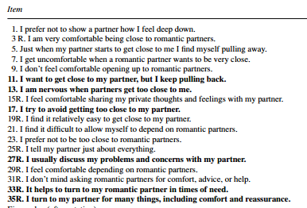
Experiences in Close Relationship Scale
The ECR (Brennan et al., 1998) 36 5-point items
“High Avoidance …tend to avoid emotional closeness and intimacy, do not feel comfortable opening up to or depending on their partner, and are reluctant to ask their partner for comfort, advice, or help.
High Anxiety.. tend to be preoccupied with their romantic relationships, worry about being abandoned, desire to be very close to their partner, and ask the partner for more feeling and commitment. “
Picardi, et al. 2010
Notes:
The current study investigated those three antecedents to adult attachment within the framework of a two-dimensional model proposed by Bartholomew and Horowitz
The first dimension, Attachment-related avoidance
Represents the extent to which individuals organize their attachment-related thoughts, feelings and behaviors around defensive goals
The second dimension, Attachment-related anxiety
Represents the extent to which individuals are concerned about the availability and repsonsiveness of close others
A secure person within this framework would be low on both dimensions
They also focused on antecedents of both global attachment styles, so about interpersonal relationships in general
As well as attachment styles pertaining to domain specific, or specific relationships contexts like romantic relationships
- They did not focus on parents

Slide 122
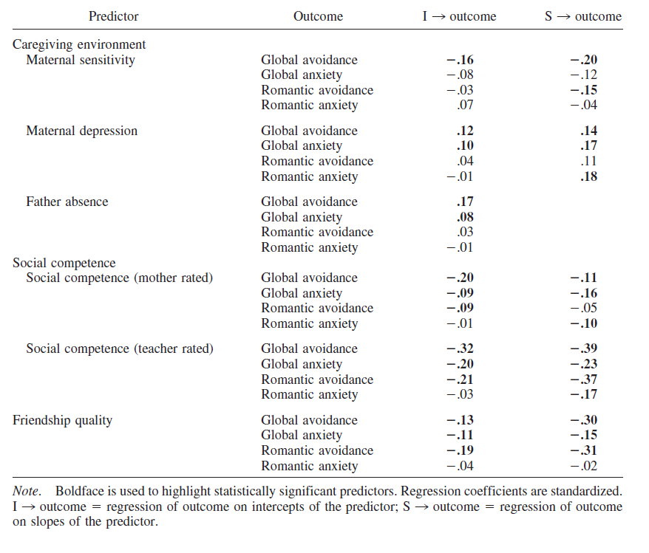
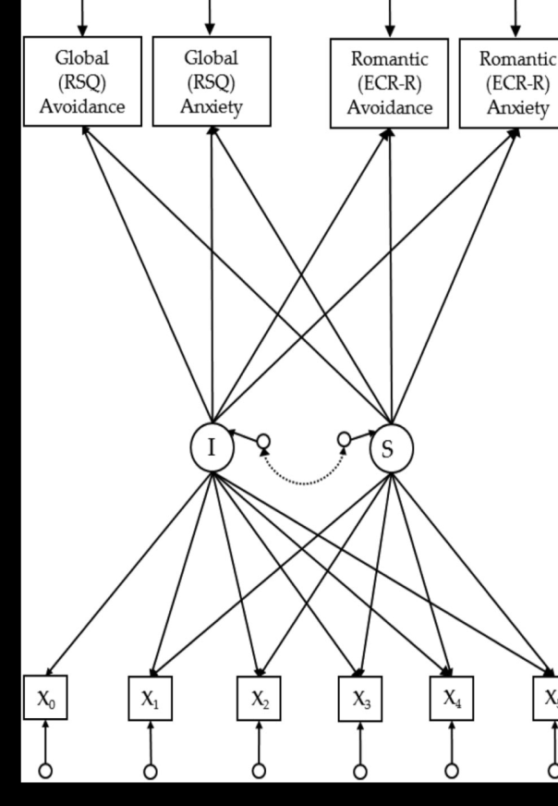
Early care impacts later attachment
Fraley, et al., 2013
Est. early sensitivity received
Est. change in qual. of care
Social Competence (M)
Father Absence
Friendship Quality
Social Competence (T)
Maternal Sensitivity
Maternal Depression

Slide 123
Regression Findings
Attachment-Related Avoidance
Attachment-Related Anxiety
Global
↑ MS = ↓ Avoidant
↓ Dad = ↑ Avoidant
↑ SC = ↓ Avoidant
↑BFF = ↓ Avoidant
Romantic
↑ Avoidant
↓ Parental Sensitivity
↓ Social competence
↓ BFF’s
Global
↑ MD = ↑ Anxiety
↑ SC = ↓ Anxiety
Romantic
↑ Anxiety
↑ Maternal Depression
↓ Social competence
↑ BFF’s
Weird!
Notes:
In general, the covariates did not predict the romantic avoidance/anxiety of the global avoidance/anxiety
AVOIDANCE:
Global:
Participants who experienced greater maternal sensitivity over time were less avoidant at age 18
Those who did not live consistently with their fathers were more liekly to be avoidant than those who did
Those who exhibited social competence early in childhood or who exhibited increasing levels of social competence were less likely to be avoidant at age 18
Those who had a high-quality best friendship early in childhood or had an increasingly high-quality best friend (if they were BFF’s) were less likely to be avoidant at 18
Romantic:
Those who were relatively avoidant in their attachment concerns at age 18 were
More likley to have experienced decreases in parental sensitivity over time
Decreases in social competence over time
Less likely to have experienced high-quality friendships in early childhood and to have increasingly low-quality friendships over time
ANXIETY
Global:
Those whose mothers reported increasing levels of depressive symptoms over time were more likely to report attachment-related anxiety at age 18
Increases in social competence over time predicted lower ratings of anxiety at age 18
Romantic:
Those who were relatively anxious with respect to attachemnt were
more likely to have mothers who reported more depressive symptoms over time
Less likely to increase in social competence over time
More likely to have friendships that increased in quality of time

Slide 124
Temperamental & Genetic Factors
Temperament
Gene & Gene X Environment
No statistically significant temperamental antecedents of adult attachment styles
No main effects of genetic variables previously studied
C allele of HTR2A (serotonin receptor gene)
Homozygous = ↑ global attachment related anxiety
Notes:
BUT individuals who were homozygous with respect to the C allele of the HTR2A serotonin receptor gene had higher global attachment-related anxiety scores than did individuals who were TT or TC

Slide 125
Baker et al., 2011
Emotion Socialization Behaviors
Attitudes about Emotion
Child Social Competence

Slide 126
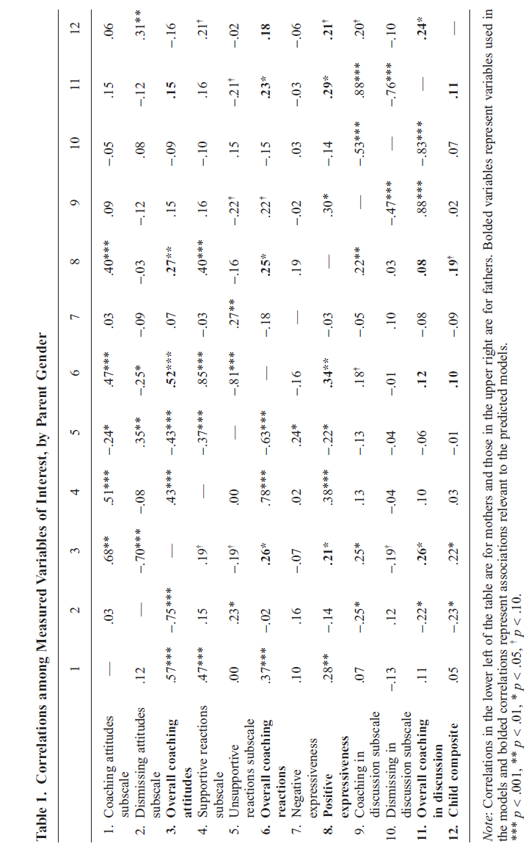
Baker et al., 2011

Slide 127
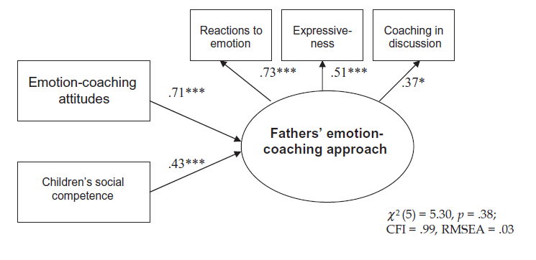
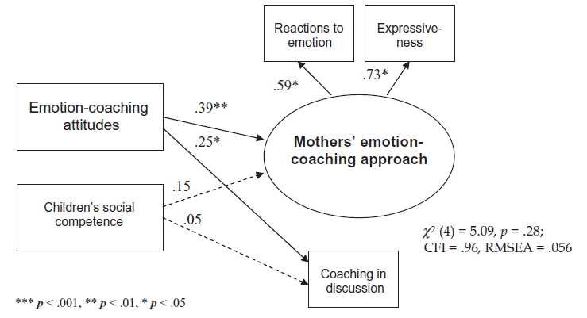
Baker et al., 2011

